Slide 1

Colorize black & white photos
Youssef boutaleb
Module : Machine Learning
A.U : 2022 / 2023

Slide 2
Plan :
Introduction
Core logic
Alpha version
Beta version
Full-version
GAN version

Slide 3
Introduction
In this project, I worked on colorizing black and white photos using a neural network. The ability to bring new life to old photographs has numerous applications, from improving visual quality to preserving historical records. I will be presenting the methods and results of my work.

Slide 4
Introduction
The first section breaks down the core logic. We’ll build a bare-bones 40-line neural network as an “alpha” colorization bot.
There’s not a lot of magic in this code snippet. This well help us become familiar with the syntax.
The next step is to create a neural network that can generalize our “beta” version. We’ll be able to color images the bot has not seen before.
For our “final” version, we’ll combine our neural network with a classifier. We’ll use an Inception Resnet V2 that has been trained on 1.2 million images. To make the coloring pop, we’ll train our neural network with Linnaeus 5 dataset

Slide 5
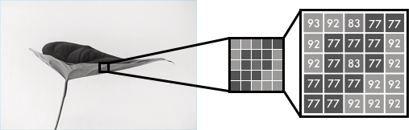
Core logic
Black and white images can be represented in grids of pixels. Each pixel has a value that corresponds to its brightness. The values span from 0–255, from black to white.

Slide 6
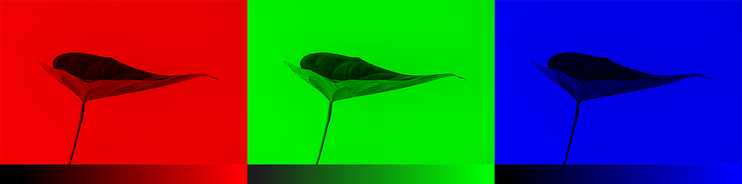
Core logic
Color images consist of three layers: a red layer, a green layer, and a blue layer. This might be counter-intuitive to you. Imagine splitting a green leaf on a white background into the three channels. Intuitively, you might think that the plant is only present in the green layer.
But, as you see below, the leaf is present in all three channels. The layers not only determine color, but also brightness.

Slide 7

Core logic
To achieve the color white, for example, you need an equal distribution of all colors. By adding an equal amount of red and blue, it makes the green brighter. Thus, a color image encodes the color and the contrast using three layers:

Slide 8
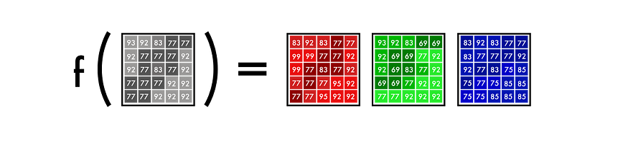
Core logic
Just like black and white images, each layer in a color image has a value from 0–255. The value 0 means that it has no color in this layer. If the value is 0 for all color channels, then the image pixel is black.
As you may know, a neural network creates a relationship between an input value and output value. To be more precise with our colorization task, the network needs to find the traits that link grayscale images with colored ones.
In sum, we are searching for the features that link a grid of grayscale values to the three color grids.

Slide 9
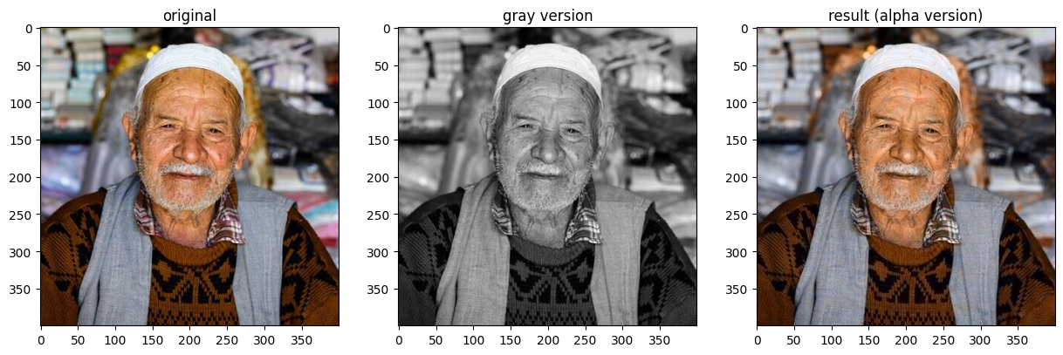
Alpha version
We’ll start by making a simple version of our neural network to color an image of a man’s face. This way, you can get familiar with the core syntax of our model as we add features to it.

Slide 10
Alpha version
Color space
First, we’ll use an algorithm to change the color channels, from RGB to Lab. L stands for lightness, and a and b for the color spectra green–red and blue–yellow.

Slide 11
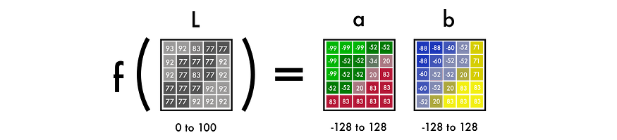
Alpha version
From B&W to color
Our final prediction looks like this. We have a grayscale layer for input, and we want to predict two color layers, the ab in Lab. To create the final color image, we’ll include the L/grayscale image we used for the input. The result will be creating a Lab image.

Slide 12
Alpha version
To turn one layer into two layers, we use convolutional filters. Think of them as the blue/red filters in 3D glasses. Each filter determines what we see in a picture.They can highlight or remove something to extract information out of the picture. The network can either create a new image from a filter or combine several filters into one image.
For a convolutional neural network, each filter is automatically adjusted to help with the intended outcome.
We’ll start by stacking hundreds of filters and narrow them down into two layers,the a and b layers.

Slide 13
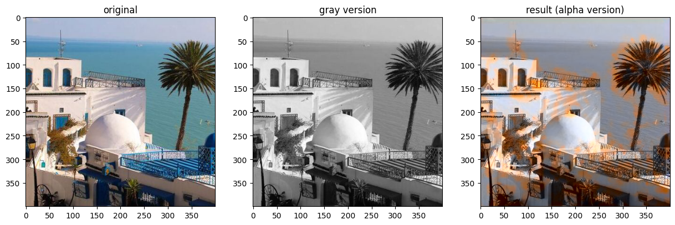
Beta version
To understand the weakness of the alpha version, try coloring an image it has not been trained on. If you try it, you’ll see that it makes a poor attempt.

Slide 14
Beta version
It’s because the network has memorized the information. It has not learned how to color an image it hasn’t seen before. But this is what we’ll do in the beta version. We’ll teach our network to generalize

Slide 15
Beta version
The feature extractor
Our neural network finds characteristics that link grayscale images with their colored versions.
Imagine you had to color black and white images but with restriction that you can only see nine pixels at a time. You could scan each image from the top left to bottom right and try to predict which color each pixel should be.

Slide 16

Beta version
For example, these nine pixels are the edge of the nostril from the woman just above. As you can imagine, it’d be next to impossible to make a good colorization, so you break it down into steps.

Slide 17
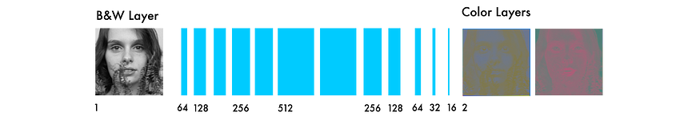
Beta version
First, you look for simple patterns: a diagonal line, all black pixels, and so on. You look for the same exact pattern in each square and remove the pixels that don’t match. You generate 64 new images from your 64 mini filters.

Slide 18
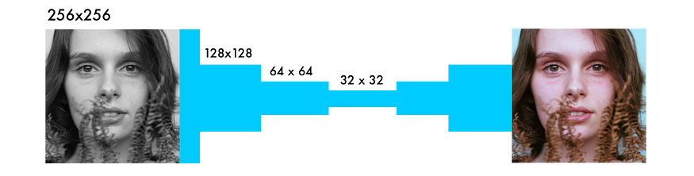
Beta version
If you scan the images again, you’d see the same small patterns you’ve already detected. To gain a higher level understanding of the image, you decrease the image size in half.

Slide 19
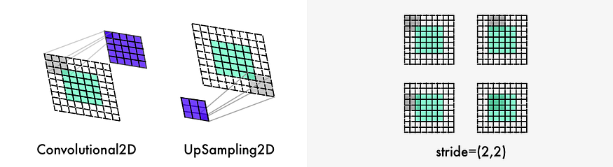
Beta version
You still only have a 3x3 filter to scan each image. But by combining your new nine pixels with your lower level filters, you can detect more complex patterns. One pixel combination might form a half circle, a small dot, or a line. Again, you repeatedly extract the same pattern from the image. This time, you generate 128 new filtered images.

Slide 20
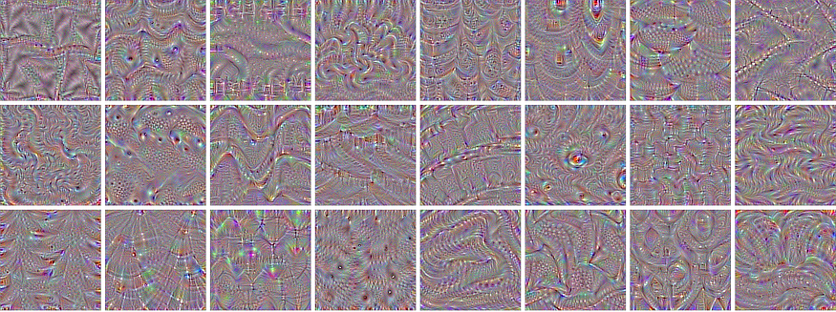
Beta version
After a couple of steps the filtered images you produce might look something like these:

Slide 21
Beta version
As mentioned, you start with low-level features, such as an edge. Layers closer to the output are combined into patterns. Then, they are combined into details, and eventually transformed into a face. This video tutorial provides a further explanation.
The process is similar to that of most neural networks that deal with vision. The type of network here is known as a convolutional neural network.
In these networks, you combine several filtered images to understand the context in the image.

Slide 22
Beta version
From feature extraction to color
The neural network operates in a trial and error manner. It first makes a random prediction for each pixel. Based on the error for each pixel, it works backward through the network to improve the feature extraction.

Slide 23
Beta version
It starts adjusting for the situations that generate the largest errors. In this case, the adjustments are: whether to color or not, and how to locate different objects.
The network starts by coloring all the objects brown. It’s the color that is most similar to all other colors, thus producing the smallest error.

Slide 24
Beta version
Because most of the training data is quite similar, the network struggles to differentiate between different objects. It will fail to generate more nuanced colors. That’s what we’ll explore in the full version.

Slide 25
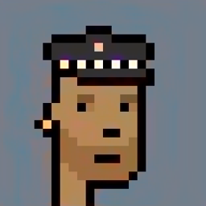
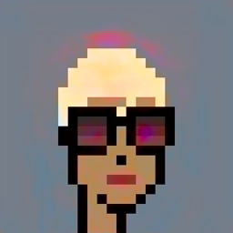
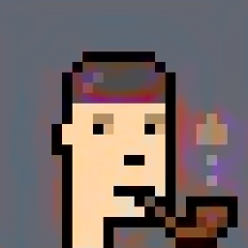
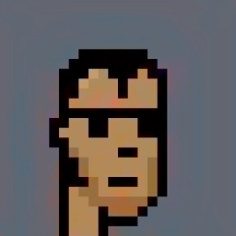
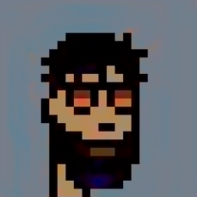
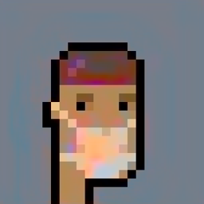
Beta version
Below is the result of coloring the validation images with our beta version.

Slide 26
Full version
Our final version of the colorization neural network has four components. We split the network we had before into an encoder and a decoder. Between them, we’ll use a fusion layer. If you are new to classification networks, I’d recommend having a look at this tutorial.

Slide 27
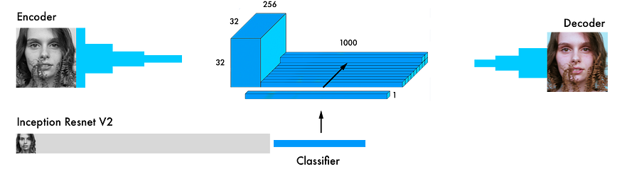
Full version
In parallel to the encoder, the input images also run through one of today’s most powerful classifiers — the Inception ResNet v2 . This is a neural network trained on 1.2M images. We extract the classification layer and merge it with the output from the encoder.

Slide 28
Full version
Here is a more detailed visual from the original paper.
By transferring the learning from the classifier to the coloring network, the network can get a sense of what’s in the picture. Thus, enabling the network to match an object representation with a coloring scheme.

Slide 29
Full version
Here is a more detailed visual from the original paper.
By transferring the learning from the classifier to the coloring network, the network can get a sense of what’s in the picture. Thus, enabling the network to match an object representation with a coloring scheme.

Slide 30
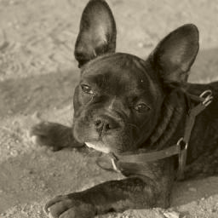
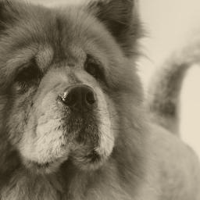
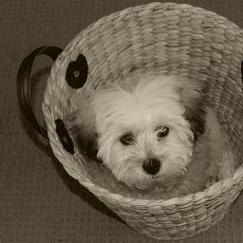
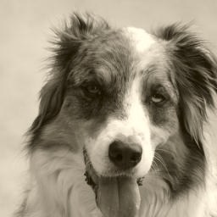
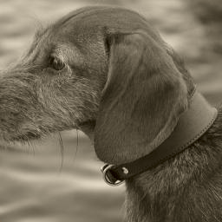
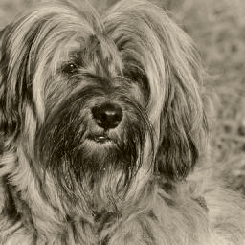
Full version
Below is the result of coloring the validation images with our Full version(not a good result because of the limited resources= not trained well).

Slide 31
GAN version using deoldify coloring network(bonus)
the GAN version is not covered in the tutorial. It's an experimental version using some of the emerging best practices in image colorization.it uses Generative Adversarial Networks to make the coloring more consistent and vibrant. However, the network is a magnitude more complex and requires more computing power to work with. Many of the techniques in this network are inspired by the brilliant work of Jason Antic and his DeOldify coloring network.

Slide 32
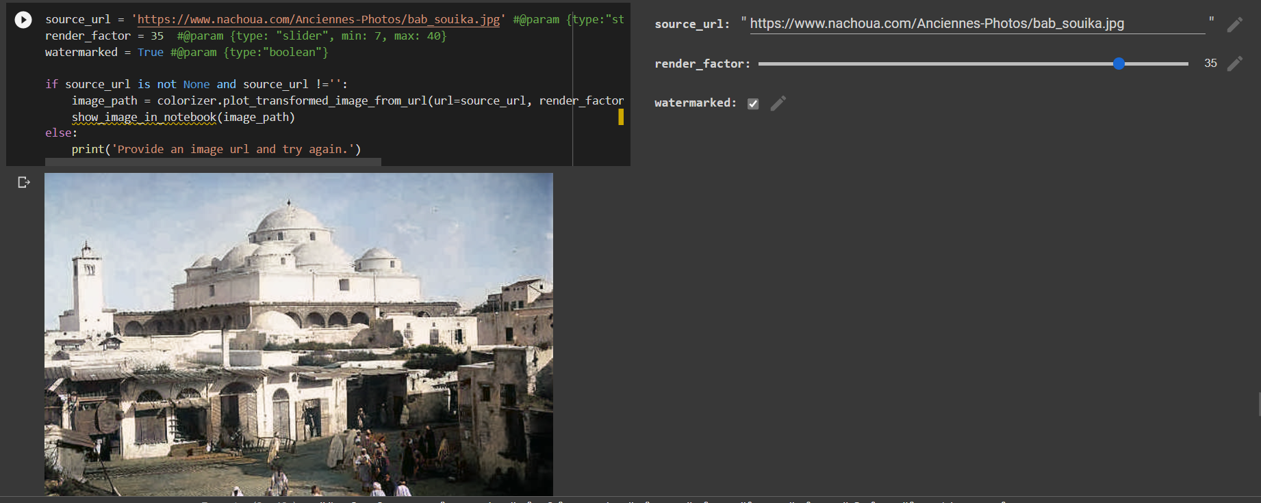
GAN version using deoldify coloring network(bonus)
I add a GAN version to my work just for testing .by putting the URL of the image and run the cell we can see the result of the GAN version

Slide 33
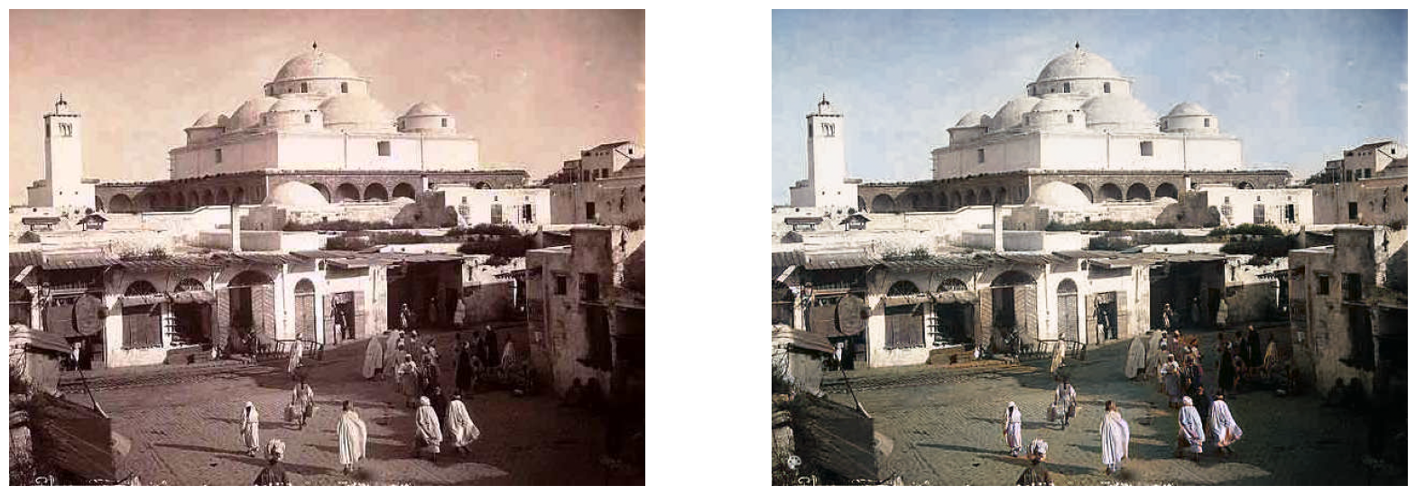
GAN version using deoldify coloring network(bonus)
It shows a good result. So I recommend you to test it
With some Photos and Old Images of Tunisia .

Slide 34
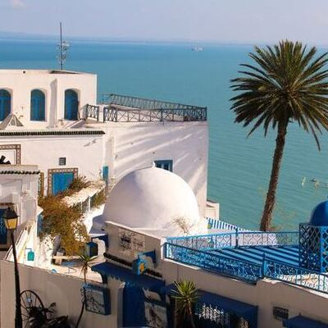
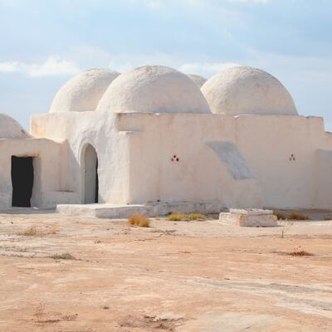
Finally
I modify the dataset for each version :
Alpha version: 4 images (SidiBouSaid.jpg, djerba.jpg, man.jpg, tunis.jpg)

Slide 35
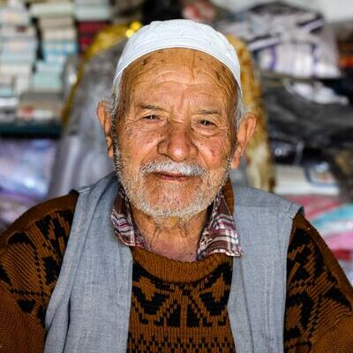
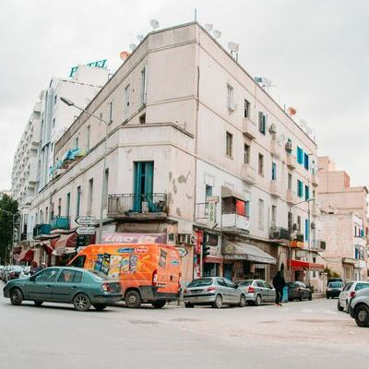
Finally
Alpha version: : 4 images (SidiBouSaid.jpg, djerba.jpg, man.jpg, tunis.jpg)

Slide 36
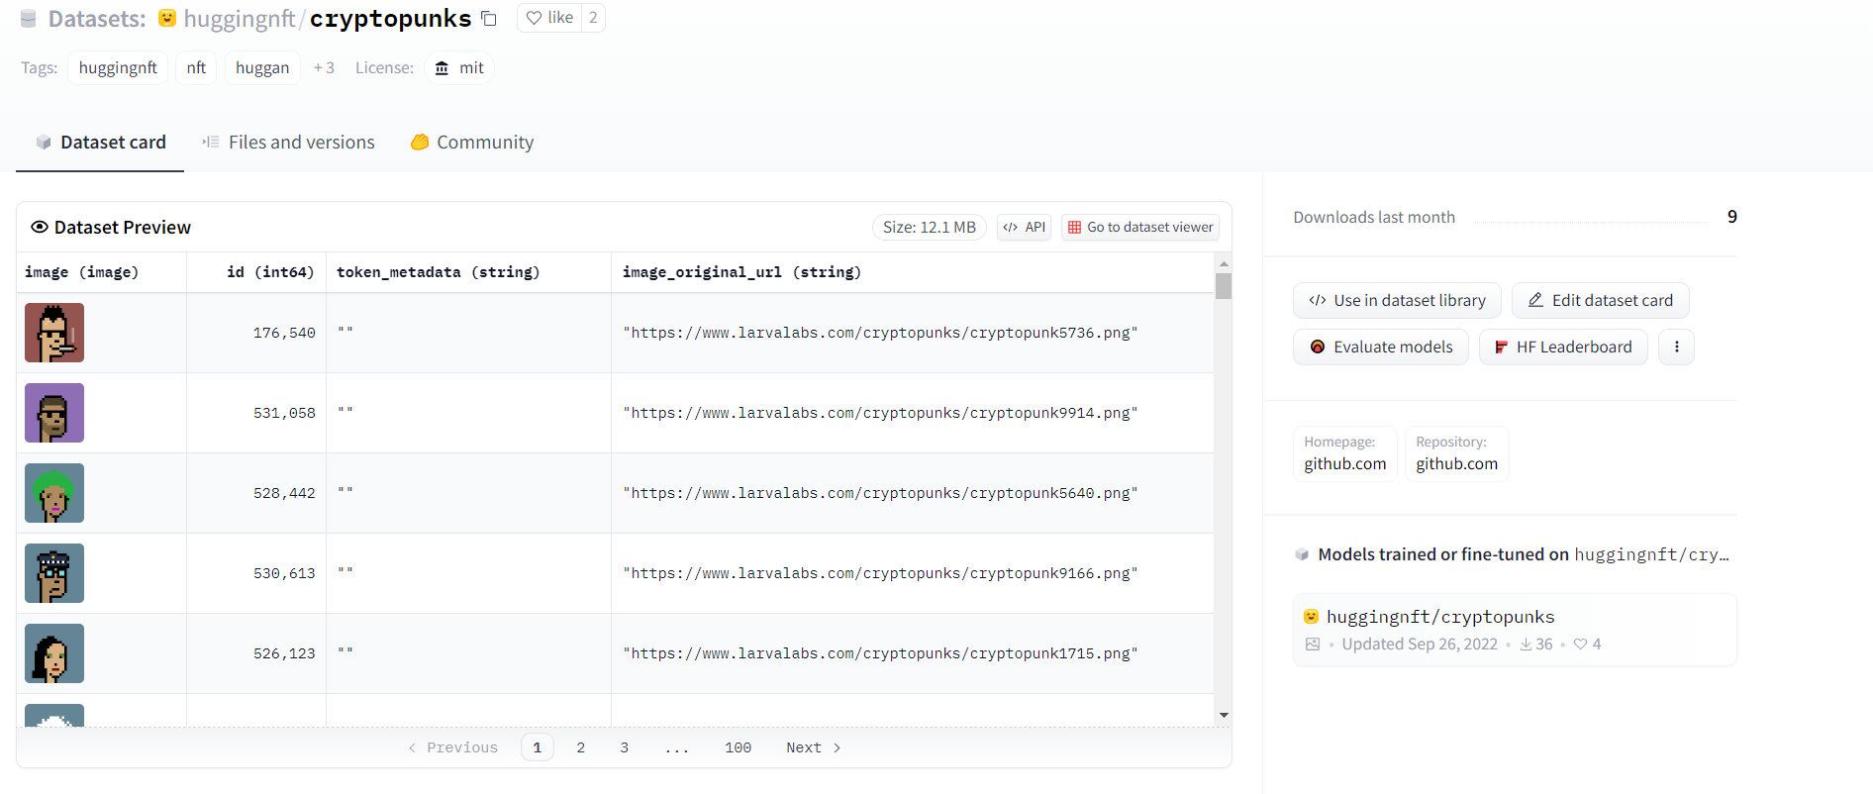
Finally
Beta version: cryptopunks dataset

Slide 37






Finally
Beta version: cryptopunks dataset

Slide 38
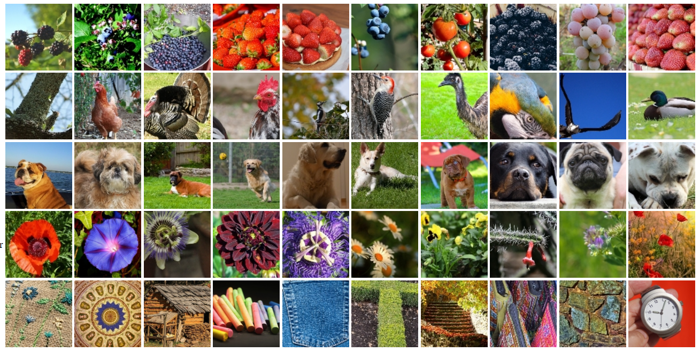
Finally
Full version: Linnaeus 5 dataset

Slide 39
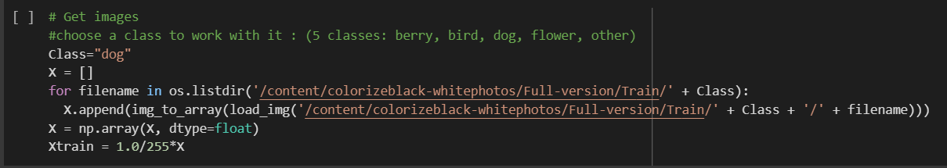
Finally
Full version: Linnaeus 5 dataset
I work just with 1 class (limited resources)

Slide 40

thanks for your attention

